Slide 1

ACCELERATED RESOLUTION THERAPY
BASIC ART TRAINING
Laney Rosenzweig, Developer
The ART of Rapid Recovery

Slide 2
DAY ONE
Foundations of ART

Slide 3

Introductions
Who are we?
  Name
  Location
  Training Date
  Experience with ART
Who are you?
  Name
  Location
  Motivation for taking the training
  Population you work with
  How did you learn about ART?
  How do you hope to use it in your practice?
Notes:
Note: Tell trainees a little about yourself, how you became involved with ART, your experience with ART, where you practice etc.
SAY: I want to welcome everyone again. My name is ________. I am from _______ and __________. Today we have, (#) assistants. They are ____.
SAY: We are interested in your motivation. Just as motivation is key for a client, it is key for learning ART. We would also like to know your motivation for taking the training, the population you work with, how you learned about ART and how you intend to incorporate ART into your practice.
DO: allow trainees to introduce themselves

Slide 4
Accelerated Resolution Therapy
(ART)
ART is an innovative therapy that focuses on eliminating negative images and sensations
ART vs other therapies
Why eye movements
Addresses - Trauma, PTS, Anxiety, Depression, Relationships, Performance Enhancement, Ongoing problems
Benefits of ART - Cognitions change naturally, often need only a few sessions, brain learns flexibility, insight often comes naturally
Often can address trauma in one session

Slide 5

Foundations

Slide 6
Criteria for ART Clients
Criteria for ART Clients
Can they move their eyes?
Can they hold a thought?
Are they self- motivated and willing?

Slide 7

ART Basic Protocol

Slide 8

ARTOMETER
Initial Body Check
1st Time Through Scene
2nd Time Through Scene
Director Scene
Transfer
Outprocessing
Reinforce Director
Pile / Bonfire
PAST
Target Trigger Times
Future
Scale of Confidence
Bar of Confidence
Seed of Doubt
New Perspective Store
Bridge / Fountain
ARTOMETER

Slide 9

Voluntary Image Replacement
Happy replaces angry

Slide 10
Eye Movements (EMs)
Smooth pursuit lateral eye movements
Keep hand / guiding device at eye level
No windshield wiper movements
Set of 40
As fast as client can tolerate – the faster the better

Slide 11
Moving Sensations
Multiple techniques with EMs
  Notice that _____ sensation
  Tools: shower, vacuum, massage, etc.
  Word Play: ___ it out, it over, or it away
  Script for Difficult /Stubborn Sensations
    Uses image to change sensation

Slide 12
Working with IMAGES
JUST LIKE A DREAM

Slide 13



Creativity
Think outside the box for suggestions – anything is possible using “dream language”
Notes:
Our suggestions are just to open up the realm of possibility for the client, not to lead them.
Remember, as good as they make their “Director” scene is as good as they will feel as their body matches their good sensations to what is happening in their scene. Make suggestions that help the client to move forward and think about the client’s needs for the session.
We get two chances to have the client make a good scene. The Reinforcing of the scene after you eliminate images from view is their second opportunity to put in good images. You can let the client know they are creating a good dream that can aid them with their problem. Make your suggestions when possible are comical or fun to break through the trauma. Humor is the opposite of trauma.

Slide 14

ART’s IMAGINARY Tools
Suggest tools: Adding an imaginary tool to the Basic protocol.
What does the client need to resolve the issue?
Anger – to speak their mind (offer a megaphone)
Shower — to shower off shame
A river — to release tears into the river let them float downstream

Slide 15
Idioms or Proverbs and ART
A group of words that has a metaphorical meaning accepted in common language
Easily identifiable expressions that work with pictures.
ART focusses on images because a picture is worth a thousand words.” Metaphorical images connect to emotional meanings.
EXAMPLES and Your Possible Suggestions
“Barking up the wrong tree” – Client can find another tree
“Every cloud has a silver lining” – Client can add their silver lining
“Don’t put all your eggs in one basket” – Client can get more baskets
“Feeling under the weather” – Client can get on top of the weather
“Make a long story short” – Client uses scissors to cut the story down

Slide 16

The Brain Likes Rhymes
If you can think of a rhyme it can serve as a great tool especially with the eye movements:
For anxiety: “Can I do anything about it right now, if no, let it go.”
Test taking:
“When in doubt; leave it out,” and come back to it later.

Slide 17
A play on words, fun, quick and effective
SOUNDS THE SAME: MEANING IS and it works surprisingly well
A play on words is very playful and effective:
ART client says: “I have a pain on my right side.”
ART clinician says: “Write about it.” - EMs
Probably will leave after one set of eye movements.
ART client says: “I have a pain on my left side.”
ART clinician says: “Erase what’s left.” - EMs
Probably will leave after one set of eye movements.

Slide 18
More Wordplay
It seems confusing the pre-frontal cortex , keeping it busy with ambiguity, can result in faster response in moving sensations.
“I have a pain in my back.”
“I have a pain in my hip.
“I have a hole in my heart.”
“Back it off.”
“Get hip.”
“Get rid of the whole thing.”
“I have a pain in my head.”
“Get ahead of it.”, “Head it off.

Slide 19
Wordplay Moves Sensations Quickly
“I have a hand pain.” – “Hand it over.”
“I have a pain in my face.” – “Face it head on.”
“I have a chest pain.” – “Get it off your chest.”
“I have jaw pain” – “Chew on this jaw breaker.”
“I have a knee problem” – “Knead it”
“I have a pain in my wrist.” = “Resist it.”
“I have a pain in my arm.” – “Arm yourself.”
“I have a pain in my toe.” – “Go toe to toe with it.”
“I have a pain in my leg.” – “Leggo.”

Slide 20
Practicum - Moving Sensations
Read the script as written
Use tools: Wordplay, Stubborn/Difficult Sensation script as needed

Slide 21
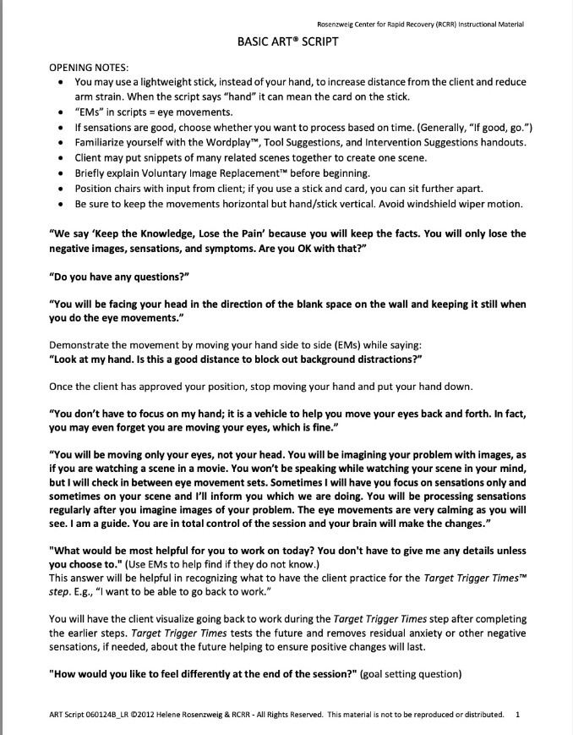
Basic Script Review
Read script verbatim
Note Scene Match instructions are highlighted
Repeat charts until client finishes scene
Director should have positive sensations after
Target Trigger Times process sensations up to twice, then move on (do not have to eliminate sensations completely)

Slide 22
DAY TWO
Practicing Basic ART

Slide 23

Components of ART
Scenes
Scene Match
Metaphors
Gestalt

Slide 24

Scene Match
Scene Match is used to find earlier scene that is the root of the distress
Follow the sensations to find earliest scene
Earlier scene becomes the main scene to process
Review original presenting scene after Bonfire, before Target Trigger Times

Slide 25
METAPHORS ARE:
The language of dreams
Changes can be made with “Dream Language”
Easier to see
Faster to work with
Can make new connections in the brain
Clients often find more fun than the “real deal”

Slide 26

Metaphorical Pictures Trigger Emotions
Songs are metaphorical. Why?
Our emotions are tied to the music and lyrics. You can remember events based on music.
You may know where you were when you heard a certain favorite song.
Adele for example, if you listen to her lyrics, “Rolling in the Deep” it is “chock full” of metaphors.

Slide 27

METAPHORS
The stuff dreams are made of:
We dream in metaphors;
If we are afraid of something we may dream of monsters.
Using ART, the clients can control the ending of nightmares, like a lucid dream that has a good ending.

Slide 28

Metaphors Are Dream Language
Metaphorical suggestions work so well with the reality that the eye movements deliver.
Clients leave with the image that they can return to again and again to reinforce ART therapy changes.
Dreams are not real, but they feel real sometimes. ART’s Director is like a dream and the client knows it’s not real, but it works.

Slide 29
What metaphors have you heard your clients say?
I’m pulling out my hair.
My back is against the wall.
I’m frozen with fear.
Yours _____________________

Slide 30
Gestalt Interventions
Good for grief, releasing anger or guilt, etc.
  Say goodbye
  Counsel, support earlier-self
  Rescue younger self
  Finish unfinished business

Slide 31
Handling
Strong Emotions or
Intense Crying
Strong emotions are processed with multiple sets of 40
Do not stop to ask if they want to process again
Offer Tools to move sensations
Can use Wordplay as they settle

Slide 32
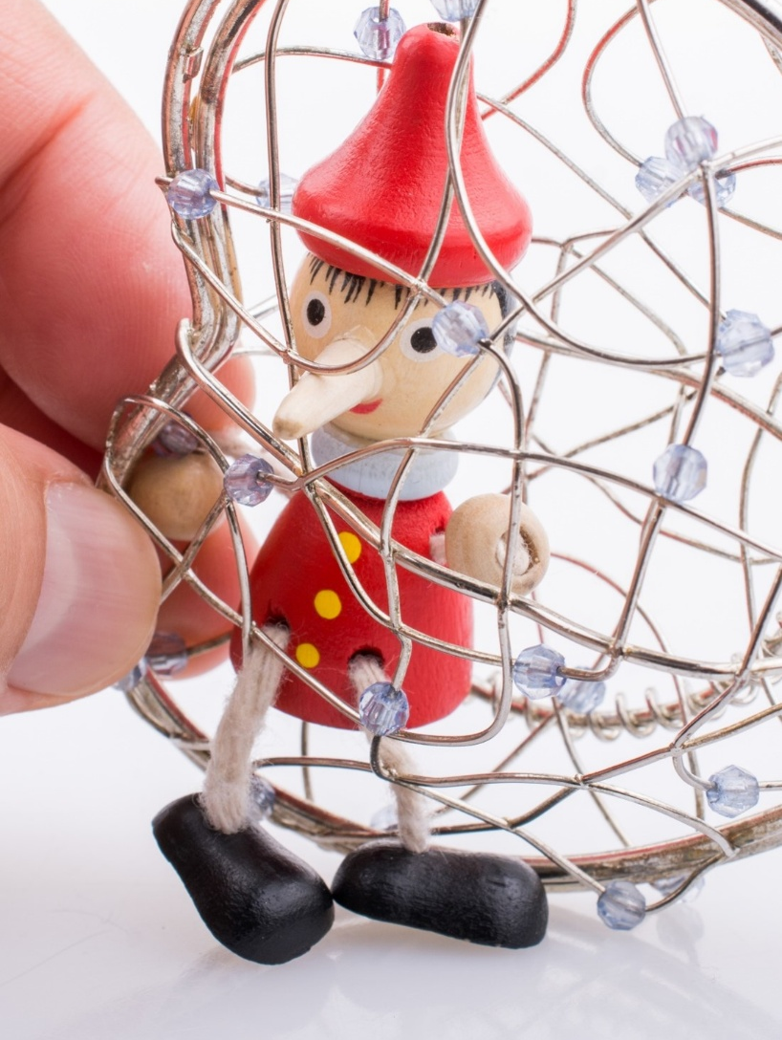
Little Mischievous Little Liar
A script to deal with the negative thoughts or negative patterns the client struggles with in the session.

Slide 33

Basic ART Practicum
Choose a real issue to process
Example: Anxiety driving in the rain after an accident in the rain
Read the Script as written
Take your Basic, Little Liar, and Difficult Sensation scripts with you

Slide 34
EMs for Self Use
Clients can be taught to use EMs for moving sensations only
Three techniques
  Two spots on wall across the room
  Goal Posts (hands in front of them)
  Using their hand to guide their eyes
Have clients practice in session before leaving

Slide 35
DAY THREE
Typical Day for Ongoing Problems

Slide 36
Ongoing Problems
Introducing the Typical Day Script

Slide 37
Past Trauma Is Often One and Done, But Ongoing Problems May Take Longer
I find past traumas can often be completed in one ART session with the Basic Script. Clients do not want the past images or their accompanying triggers, which is helpful for motivation. Even an entire childhood can be done in one session with snippets of the worst parts comprising a client’s scene. The brain often doesn’t need more than snippets.
Ongoing issues are different because the motivation to change may be interfered with by a secondary gain. We need a different kind of script to deal with such ongoing issues.

Slide 38

Introducing
The Typical Day Script with (or without)
The Mischievous Little Liar
Ongoing problems need a script different from (though similar to) the Basic script. We call it The Typical Day script because the client will see their scene as symptoms during a typical day.
In this script, the client will see their Typical Day as they imagine their symptoms throughout the day, from morning until bedtime.

Slide 39

Ongoing Problems May Take Several More Sessions
With secondary gains that support the negative behaviors or negative thinking, an ongoing problem may need more ART sessions. Still, there should be fewer sessions than in cognitive-based therapies.
In cases involving cravings or compulsions, I find a timing of two sessions a week for one or two weeks can help lessen or eliminate the cravings or compulsions. Cravings are sensations that can be moved.

Slide 40

The Typical Day Script Is Very Similar to the Basic Script but Tailored to Ongoing Problems.
With ongoing problems and a secondary gain (a reason to hold onto a problem), the client may have a more difficult time with changing behavior and moving forward than a client getting rid of triggering images from past trauma.
Therefore, we need to combat the secondary gain by having the client choose a metaphor for the mischievous internal voice that says, don’t change.

Slide 41

Externalization
The Mischievous Little Liar voice throws the client off their game by telling them to do negative behaviors or not do positive behaviors. We externalize the problem, giving them a voice to battle against the Little Liar to stay on track.

Slide 42

The Mischievous Little Liar –
How ART Deals with Ongoing Problems

Slide 43

The Mischievous Little Liar Script
The client chooses a imaginary character for their Mischievous Little Liar voice and their support-self voice.
The client can then fight their negative voice with their support self’s help.
This script is especially good for addiction, but also good for anytime a client is battling a problem.

Slide 44

The Mischievous Little Liar – A Mischievous Voice, an Ominous Look
ART trainees use The Mischievous Little Liar script during their practicum. For example, many have used the script to fight against a reluctance to begin or stick with an exercise routine. Their little liar may be saying something like, “You’re so comfortable – why exercise?”

Slide 45

Examples of battles with the Mischievous Little Liar:
A Client’s Mind Hears…
An alcoholic’s liar: “You can drink. You’ve been good today. One drink won’t hurt.”
OCD: “If you don’t touch the wall 7 times, something bad will happen!”
Eating Disorder: “You are fat. Keep refusing to eat. They can’t make you eat. At least you have control of what you eat.”

Slide 46

There Is Also a Positive Voice
In the script there is also a positive voice that encourages the client to stay on track. ART calls this “The Support Self.”
For example, it can be pictured as an angel or anything else they want.
The client gets to choose the voices and images of both the Little Liar and Support Self.

Slide 47
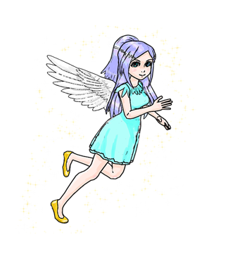

Externalization
Externalizing the problem with Metaphors
Example of “The Little Liar”
Here is an example with the result on the next slide
Client’s OCD – “Check the car oil every hour.”
Devil vs. Angel

Slide 48
Externalization
Example Result
The client finished a set of eye movements and said,
“The devil said, check the oil, the angel said, no you don’t.”
“So, I let them argue it out while I went into the kitchen and made a peanut butter & jelly sandwich.”

Slide 49

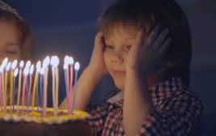
Making New Connections
Make suggestions to “plug” clients into something positive. For a child who is afraid of the dark, for example, you might use a set of eye movements to have them make positive connections to the dark such as blowing out birthday candles, fireworks or whatever positive connections they choose.

Slide 50

Doors to Explore
Addiction: Explore beyond the two doors; one is what happens when you keep your addiction, and one door leads to a life without the addiction.

Slide 51

ART Stores For Anything
A store for:
Confidence
Joy
New parents
Anything the clients wants in their positive ART imagination!

Slide 52
An ART Store for A:
New attitude
New idea
Happy thoughts
A shield
Resolution
A store filled with anything the client needs
Notes:
More stores. You can get anything there.

Slide 53

An Example of added interventions at the back of your manual:
Challenging core beliefs through Metaphor
The Train to Perfection – Suggest the client board the Train to Perfection. The conductor appears to say the train never goes to perfection. It ends at the beautiful and peaceful “Good enough is perfect” stop. The client can get out and explore the stop before perfection.

Slide 54
And More Scripts
Preview: Advanced Training includes scripts for:
Performance Enhancement
Performance Enhancement for Reading
Annoyances
ADHD

Slide 55
End of training and what comes next
The following slides include optional ART resources and are not considered CE-required content

Slide 56


ART Organizations
The Rosenzweig Center for Rapid Recovery (RCRR)
You can sign up immediately after training and attend Basic and Advanced consultations
Provides Certification for all trainings; Ongoing Consultation calls with Laney and Amy
Sign up for a profile on the IS-ART website; Conference Discounts; Peer Support and More!
Founder’s Original Organization
Provides All Training Levels
Notes:
Need to determine what to say about this and/or where to include it

Slide 57
ART Training and Certifications
Basic ART Training (3 days): Provides therapists/clinicians with the foundation, knowledge and skills to effectively implement use of ART in clinical practice for trauma and other mental health problems.
Advanced ART Training (3 days): Advanced techniques using metaphors, including how to use a metaphor as a stand-alone intervention, good for resolving issues without a clear precipitating event.
Prior to registering for Advanced, Basic training and 30 client ART sessions must be completed and the session log will be provided after the training
Receive additional scripts for ADHD and other issues

Slide 58
ART Training Certification
Certificate of Completion: After all paperwork is completed and submitted
Certification for Basic
  Complete 3 day Basic ART Training
  Join IS-ART and maintain yearly membership www.is-art.org ($150/year)
  Submit log tracking 30 client ART sessions (Include: date of session, client initials, presenting problem, and outcome)
  Attend (and participate in) at least 1 IS-ART member group Zoom consultation
  Take Basic Certification Test (through IS-ART)
Certification for all levels: After each training, members of IS-ART take an online test

